Slide 1
2020 Paper Implementation
GhostNet : More Features from Cheap Operations
Video link : https://drive.google.com/file/d/1nBAYDCmdOqU4L5ubr_M-GrRtiI3RgbHz/view?usp=sharing

Slide 2
The problem
Problem
Context
Problem statement
Deploying CNNs on embedded devices is difficult due to the limited memory and computation resources.
In the past, methods like network pruning, low-bit quantization, knowledge distillation, etc has been used to investigate compact deep neural networks but mostly performance of these methods are upper bounded by the pre-trained deep neural networks used to baseline these technologies.
This project propose the Ghost module to generate more feature maps from cheap operations.

Slide 3
Solution
Using the Ghost module to generate more feature maps from cheap operations.

Slide 4
Challenges deep-dive
Step 1
Step 2
Approach
We will first introduce the Ghost module to utilize a few small filters to generate more feature maps from the original convolutional layer, and then develop a new GhostNet with an extremely efficient architecture and high performance.
Assuming input X ∈ R ^{c x h x w} operation of a cnn layer would be Y = X * f + b ; where Y ∈ R ^{c’ x h’ x n} and f ∈ R ^{c x k x k x n} . Now during this convolution procedure, the required number of FLOPs will be (n. h’. w’. c. k. k), and this number as n(number of output filters) and c(number of input channels) are generally large, would be really large.
CNNs have redundant features and learning all of them increases the computation cost. Here, instead of learning all the redundant features we are reducing the cost by generating the redundant features through cheap linear transformations of the smaller set of intrinsic features.

Slide 5
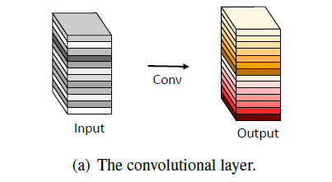
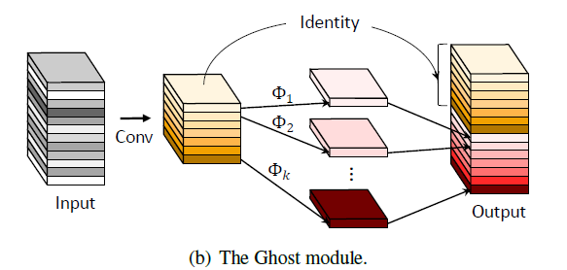

Slide 6
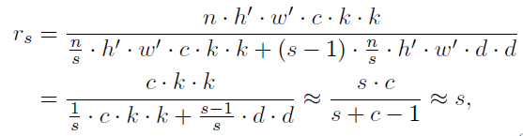
As experiments have suggested, the output feature maps of CNNs often contain much redundancy, the paper suggests that instead of learning all these feature we learn only a few intrinsic features (m; m<n) and expand it to n features via linear transformation(Φ_{k}). The cost of linear transformation is very less compared to the cost of learning. Hence, the theoretical speed-up ratio (r_{s}) for upgrading one cnn layer to a ghost module can be quantified as:
where d × d(average size of kernel) has the similar magnitude as that of k × k, and s ≪ c is the ratio of total output filters to to the number of intrinsic filters learned (s = n/m)

Slide 7
Dataset
Dataset : contains 4 classes having 50 training images each. We generated 12 images for each image using image augmentation.
We also separated a validation set of randomly chosen 10 images for each class from training set.
In Total:
Training Images = 2,400
Validation Images = 40
Test Images = 40.

Slide 8
Experimental Results
Results : We designed the ghost module to tackle the satellite image classification task. We replaced the CNN layers with the ghost model and modified it according to our requirements by adding a softmax layer at the end after the linear layer and changing its output layers.
Training was difficult due to system constraints and it took a lot of time to execute, tune hyperparameters and improve its performance.

Slide 9
Conclusion
To reduce the computational costs of recent deep neural networks, this paper presents a novel Ghost module for building efficient neural architectures. The basic Ghost module splits the original convolutional layer into two parts and utilizes fewer filters to generate several intrinsic feature maps. The experiments conducted on benchmark models and datasets illustrate that the proposed method is a plug-and-play module for converting original models to compact ones while remaining the comparable performance. In addition, the GhostNet built using the proposed new module outperforms state-of-the-art portable neural architectures, in both terms of efficiency and accuracy.

Slide 10
The Team
Harsh Kumar - 200020056
Anudeep Verma - 190010009
Ayush Sarraf - 190010014
Deepak Kumar Meena - 190010020

